Slide 1
MONEY MATTERS

Slide 2
FINANCIAL AID & SCHOLARSHIPS

Slide 3
CONNECT WITH US!
OFFICE OF FINANCIAL AID
OFFICE OF ACADEMIC SCHOLARSHIPS
finaid.uark.edu
finaid@uark.edu
479-575-3806
scholarships.uark.edu
scholars@uark.edu
479-575-4464
Check To Do items in UAConnect, UARK email account, and our websites for information and requirements for scholarships, loans, and other aid.
114 Silas H. Hunt Hall | 8 a.m. to 5 p.m.
Virtual & Walk-in Appointments Available

Slide 4
FINANCIAL AID NOTICE & NEXT STEPS
Direct Loan is $5500 for freshmen
Most outside scholarships will be on UAConnect after the first week of classes
NRTA is reflected in the bill as “Non-Resident Tuition SCHL AWD”
How It All Works brochure sent with FAN and available at finaid.uark.edu
Information about eligibility, NRTA, Work Study, student loan setup instructions, and PLUS Loan application instructions

Slide 5
DISBURSEMENT & RENEWAL
ENROLLMENT REQUIREMENTS MUST BE MET EACH SEMESTER.
Minimum 6 hours for undergraduate students using loans
Minimum 15 hours for Arkansas Academic Challenge and Governor’s Scholarships, 30 hours to renew. GPA requirements differ, refer to ADHE rules
Chancellor’s, Silas Hunt, and other University Scholarships require a minimum of 12 hours per semester for disbursement. Renewal requires 30 hours per year and 2.75 GPA
No minimum hours for Non-Resident Tuition and Alumni Legacy, but renewal requires completion of 24 hours per year and a 2.75 GPA
Concurrent and AP credits from high school do not count for disbursement or renewal requirements for Challenge or Governor’s Scholarships but may count for UA and other scholarships
Notes:
Around here, give the speaker the 5 minute warning.

Slide 6
ADDITIONAL AID OPTIONS
PARENT PLUS LOAN
PRIVATE ALTERNATIVE LOAN
Federal Student Aid loan program
Loan fees and interest rates same for every borrower, set yearly
Apply at studentaid.gov after bill is generated
Parent completes application and is responsible for repayment
Credit-based lending companies
Fees, terms, and interest rates differ between lenders and dependent on credit of borrower
Research before applying
Borrower and/or co-signer could be student, parent, or other

Slide 7
ADDITIONAL AID OPTIONS
VETERAN’S BENEFITS
THIRD PARTY SOURCES
Chapter 30 GI Bill
Chapter 33 Post 9/11
Contact the Veteran and Military-Affiliated Student Center (VMSC) or visit vmsc.uark.edu
529 plans and prepaid tuition and college savings plans
AR Vocational Rehabilitation funds
Employee dependent discounts
Contact Treasurer’s/Student Accounts Office or visit treasurer.uark.edu
Notes:
Give the speaker the 2 minute warning around here.

Slide 8
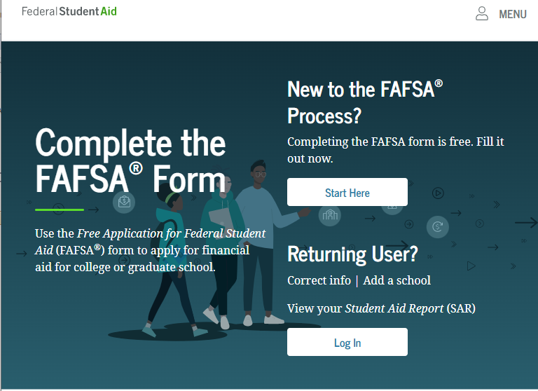
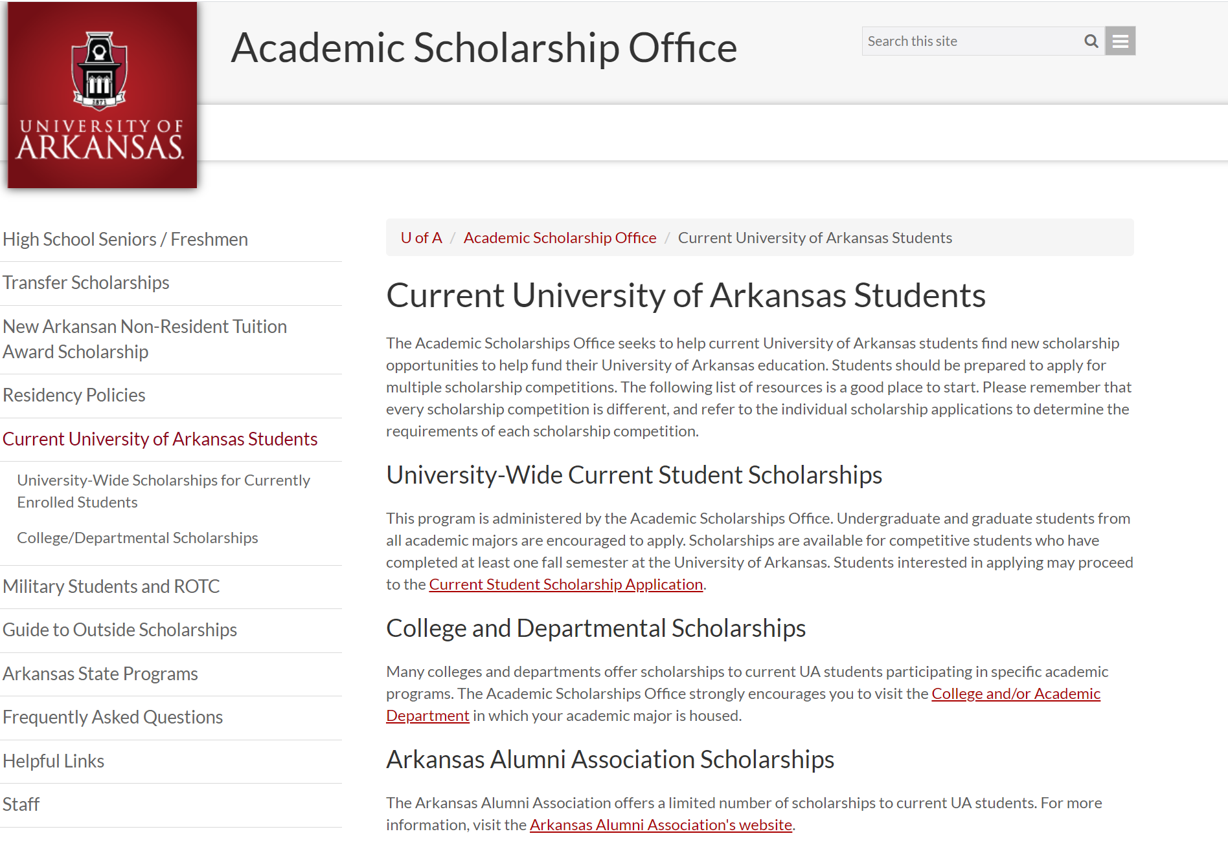
APPLY EACH YEAR
LOANS, GRANTS, & WORK STUDY
SCHOLARSHIPS
A FAFSA is required each year. Applications are available at studentaid.gov
Current student scholarship application open January 1 at scholarships.uark.edu

Slide 9
TREASURER’S OFFICE

Slide 10
TREASURER'S OFFICE & STUDENT ACCOUNTS
WHAT WE DO
CONNECT WITH US!
treasurernet.uark.edu
treainfo@uark.edu
479-575-5651
640 N. Garland Ave. Ste. 108
Student Invoices
Cashiering
Account Inquiries
Tuition Waivers
Collections
3rd Party Billing
Monday - Friday 8 a.m. to 5 p.m.

Slide 11
HOW MUCH WILL IT COST
COSTS VARY EACH SEMESTER BASED ON
Credit Hours
College
Residency Status
Student Career Level
Type of Program
TUITION AND FEES ARE CHARGED
Per Credit Hour
MANDATORY STUDENT FEES
Network/Data Systems Fee
Library Fee
Health Fee
Student Media Fee
Transit Fee
Student Activity Fee
Facilities Fee
COLLEGE FEES
Arts & Sciences
Architecture
Engineering
Agriculture, Food & Life Sciences
Education & Health Professions
Business
Nursing
Housing and meal plan costs also vary based on student selection. Please visit housing.uark.edu.

Slide 12
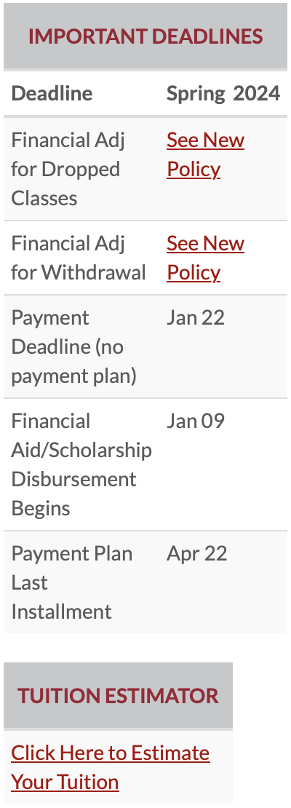
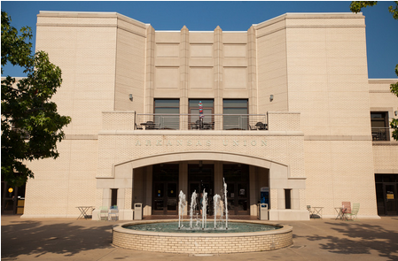
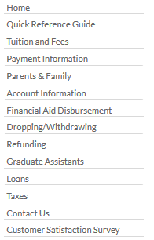
OUR WEBSITE
Notes:
Around here, give the speaker the 5 minute warning.

Slide 13
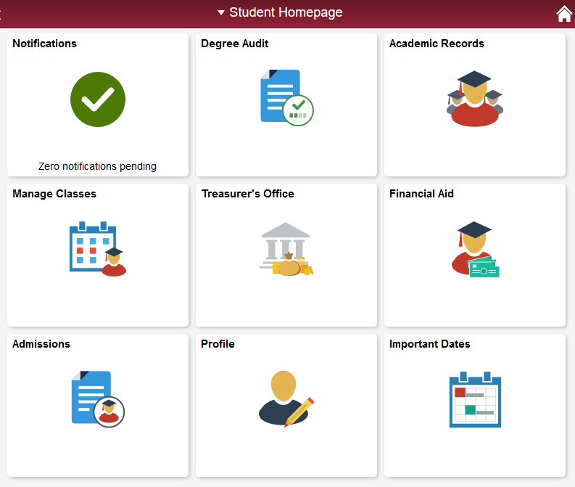
NAVIGATING UACONNECT
NOTIFICATIONS
To Do Lists
Holds
Activity Guides
Financial Agreement
TREASURER’S OFFICE
Account Balance
Summaries by Term
Make a Payment
Payment Plans
Refunding Options
Payment Authorizations
PROFILE
Your Contact Information
FERPA 3rd Party Release
RazALERT Settings
Parent/Family Access
Emergency Contact

Slide 14
If a refund preference has not been selected, your refund can be delayed up to four weeks. Even if you are not expecting to receive a refund, please set up a refunding preference.
UAConnect
Treasurer’s Office Tile
Refunding Options
Set up direct deposit into an existing account
Your money, delivered your way!
Your school has partnered with BankMobile to deposit your money or refund quickly and securely.
You will have two electronic options to deposit your money. To avoid delays in accessing your money, you must select a refund option. The BankMobile Vibe Checking Account is one of you refund options but you are not required to open this account to receive your refund.
Visit refundselection.com for more information.
REFUNDS

Slide 15
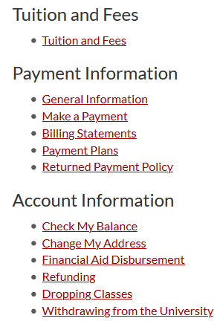
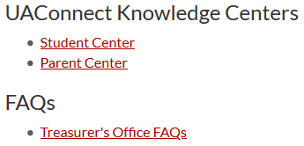
HELP CENTERS
TUTORIALS WITH STEP-BY-STEP ILLUSTRATIONS & HOW TOS
Make a Payment
Set Up Parent Authorizations
Add Authorizations
Set Refund Preferences
... and More!
Visit treasurernet.uark.edu/student_family for more information

Slide 16
The Registrar’s Office determines drop and withdrawal deadlines. Before dropping classes or withdrawing, refer to this calendar to be sure you understand the financial implications it could cause. When in doubt, contact us!
The academic semester calendar can be found on the Registrar’s website. The Fall 2024 calendar is available now.
THERE IS A $45.00 WITHDRAWAL FEE
DROPPING & WITHDRAWING ARE DIFFERENT
KNOW THE FINANCIAL RELATED DEADLINES
WITHDRAWING CAN AFFECT FINANCIAL AID ELIGIBILITY
DROPPING & WITHDRAWING
Notes:
Around here give the speaker the 2 minute warning.

Slide 17
CHECKLIST
REQUIRED
Financial Aid Agreement
(UAConnect – Notifications – To Do)
HIGHLY RECOMMENDED
Select Refunding Preference
(UAConnect – Treasurer’s Office – Refunding Options)
Parent/Family UAConnect Authorizations
(UAConnect – Profile – Grant Parent/Family Access)
FERPA 3rd Party Release
(UAConnect – Profile – FERPA 3rd Party Release)
E-Commerce Payment Authorizations
(UAConnect – Treasurer’s Office – Family Payment Authorization)
Student Permissions for Title IV Aid
(UAConnect – Notifications – To Do)
IRS 1098-T E-Consent Form
(UAConnect – Notifications – To Do)

Slide 18
CONNECT WITH US!
CONTACT INFORMATION
ON SOCIAL MEDIA
treasurernet.uark.edu
University of Arkansas-Fayetteville
Treasurer's Office
@UofATreasurer
& via chat online
treainfo@uark.edu
479-575-5651
640 N. Garland Ave. Ste. 108
Monday - Friday 8 a.m. to 5 p.m.

