Slide 1
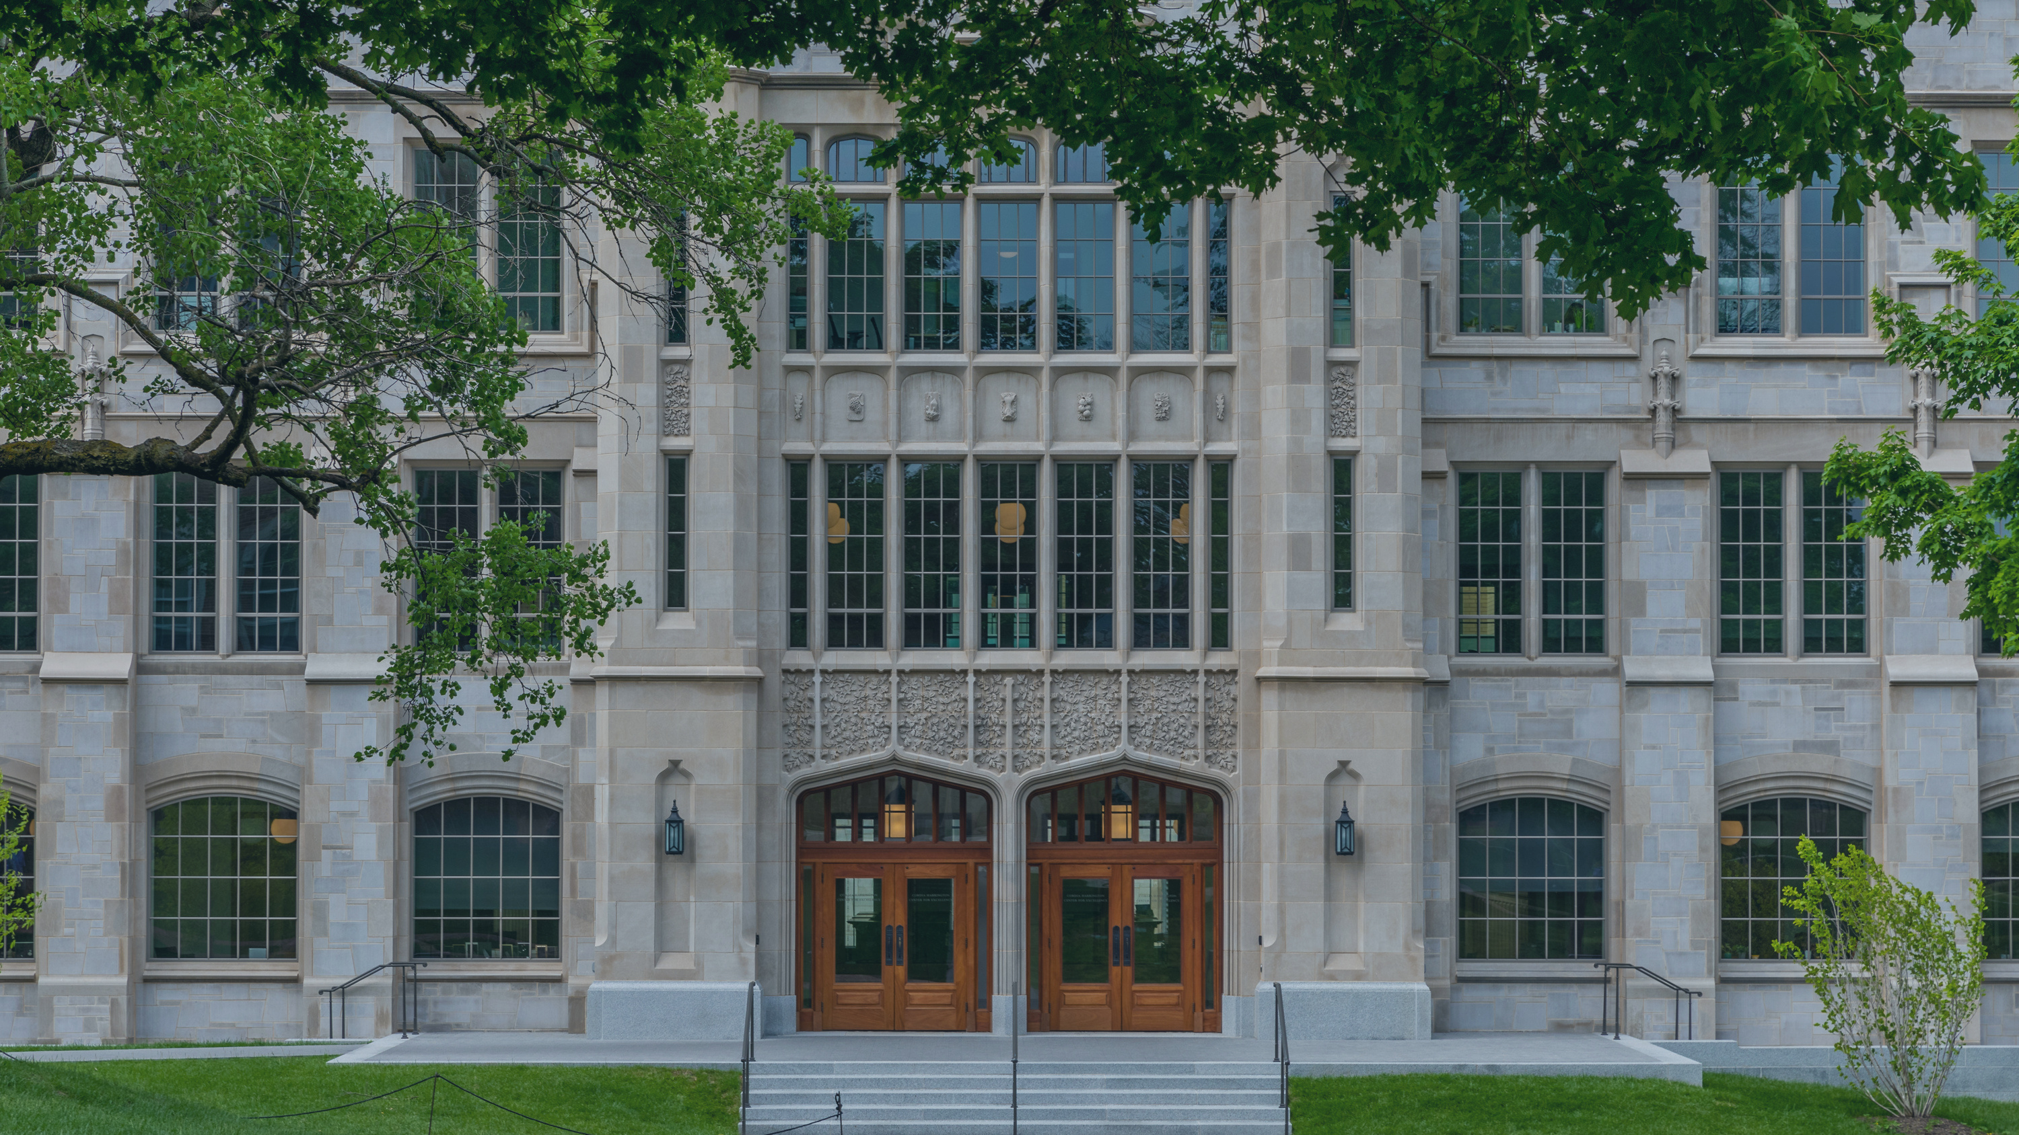
STUDENT SUCCESS
AT THE CORD

Slide 2
BUILDING BLOCKS OF SUCCESS
Intellectual Virtues
Courage
Perseverance
Carefulness
Honesty
Curiosity
Fair-mindedness
Humility

Slide 3
An introduction to intellectual virtues (building blocks) and how they help with social and academic confidence.
An introduction to campus partners and resources.
A safe space to ask questions and connect with students, faculty, and staff in a small class setting.
UNIVERSITY PERSPECTIVES

Slide 4
Academic Coaching
Supplemental Instruction
Tutoring
Writing Studio
Tutors clarify course content, demonstrate how to solve problems, and provide an individualized experience to students in over 150 university courses through appointments, drop-ins, and Study Halls.
Writing Studio consultants offer feedback on students' writing at any stage in the writing process and help students improve their academic writing skills.
Peer academic coaches help students elevate their academic performance by identifying and developing academic skills and strategies for learning efficiently and effectively.
For select historically challenging courses, SI offers weekly, collaborative study sessions facilitated by students who have excelled in the course and want to share their expertise.
ACADEMIC INITIATIVES

Slide 5
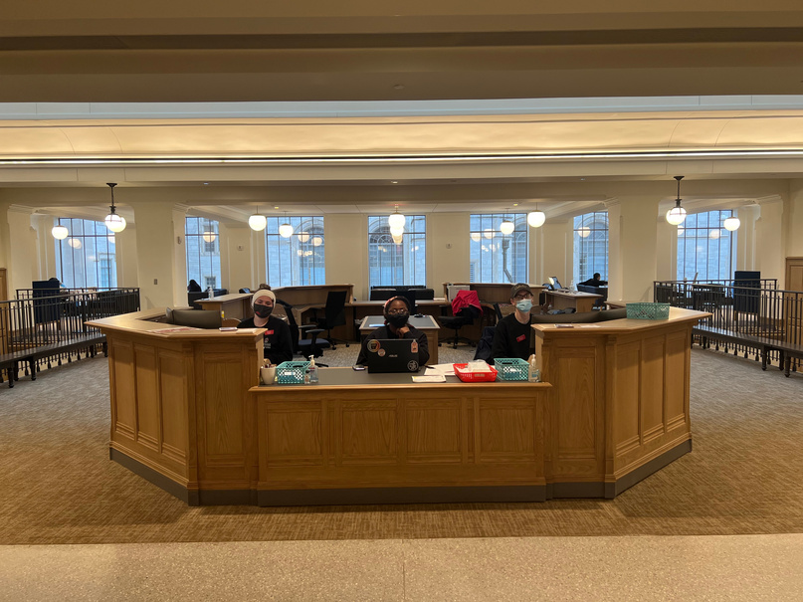
OTHER CORD RESOURCES
Welcome Desk
Exploration Coaches
ASAP | 360
Student employees are always ready to help with campus navigation, course enrollment, Blackboard support, and more.
Exploration Coaches offer holistic major exploration support in one centralized location, so students don’t have to visit multiple offices to get the guidance they need.
Designed for first-generation and Pell eligible students, these programs provide one-on-one staff support and peer mentoring to assist with academic transition, financial planning, social engagement and wellness.

Slide 6
WHAT ELSE IS IN THE CORD?
Career Studio
Starbucks & The Drove
Academic Advising
The Career Studio provides one-on-one and group advising/coaching for some of the Office of Career Connections’ most popular services, including resume and cover letter reviews, interview tips and mock interviews.
The Drove serves quesadillas, smoothie bowls, and ramen to fuel you while you study! There is also a Starbucks to keep you caffeinated. Both are located on the ground level of the CORD.
All academic advisors for COEHP & Fulbright are housed at the CORD, providing a centralized location for academic advising appointments and support.

Slide 7
ACTION STEPS FOR SUCCESS
Find your space
Get to know “turnitin” software
Build your support network early
Visit the libraries, the CORD, the Union and more to discover a space you love for designated studying!
Familiarize yourself with academic integrity policies and commit early to doing your best work!
Connect with tutors, coaches, advisors, and mental health resources in the first few weeks of the semester!

Slide 8
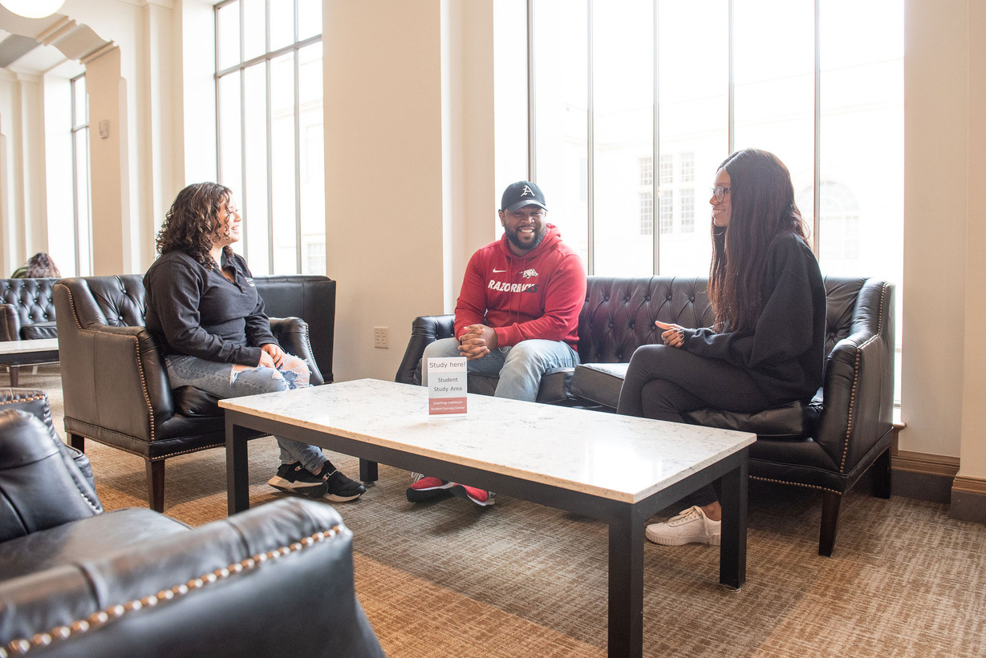
CONNECT @ the CORD!
CONTACT INFORMATION
success.uark.edu
success@uark.edu
479-575-3174
@UARKSuccess
Visit the CORD

